Slide 1
911-988-211
Dianna Caber, Communications Center Manager, South Sound 911
Courtney Colwell, Director of 988 Services, Volunteers of America
Penni Belcher, 211 Director, United Way of Pierce County
Notes:
All

Slide 2
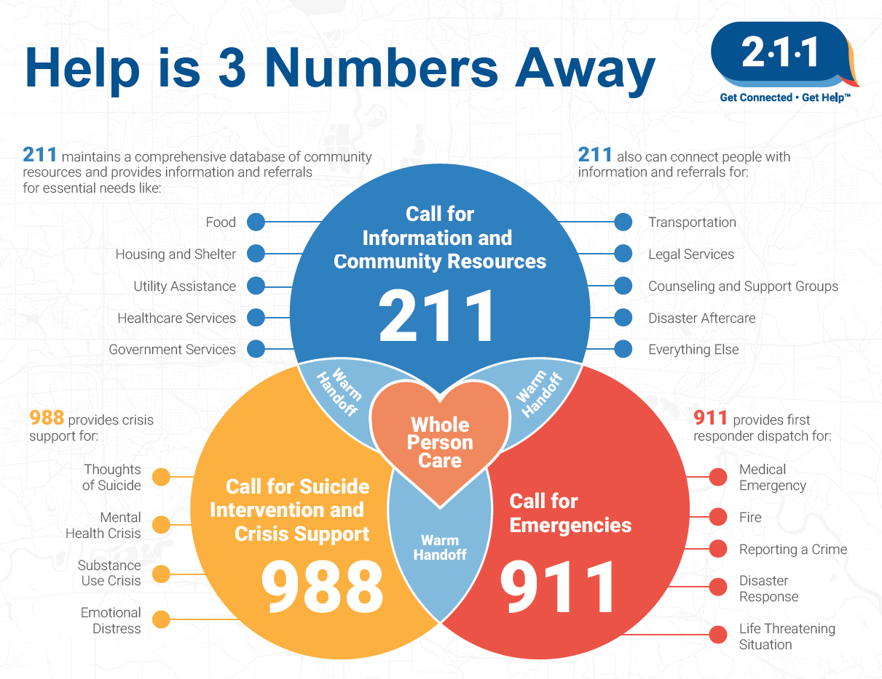
Intersection of 911, 988, and 211
Notes:
Penni provide brief overview

Slide 3
911
2023 total contacts
638,556 emergency
349,941 non-emergency
3,785 text-to-911
911 is the “Universal Emergency Number” across the United States
Provides urgent and emergent response in potentially life-threatening situations
Also receives calls related to mental health and basic needs
South Sound 911 is a regional 911 Center
The largest call volume for PSAPs in Washington State
Answer over 1 million emergency and non-emergency calls and over 3,800 texts-to-911 annually
Dispatching 19 law enforcement and 17 fire/EMS agencies
Notes:
Dianna

Slide 4
988
2023 total contacts
79,226
The 988 Suicide and Crisis Lifeline is a continuation of the National Suicide Prevention Lifeline
As of July 16th 2022, the NSPL could be reached by calling or texting 988
988 provides many services related to mental health:
Emotional support
Crisis de-escalation
Suicide safety assessments
Safety planning
Connection to resources
Follow-up
Notes:
Courtney

Slide 5
211
2023 total contacts
74,198
211 provides many services to meet basic needs:
Information and referral (I&R)
Creative conversations
Screening, intake, application submission
Top five requests for services include:
Housing & shelter
Utilities
Legal & government services
Transportation
Food
Notes:
Penni

Slide 6
911 and 988
The 988 and 911 Mental Health Crisis Call Diversion Program launched in June 2023
First of its kind in Washington State
Vision is to divert mental health calls from the 911 system so mental health-related 911 calls receive a mental health response via 988
988 Counselors are co-located on site at South Sound 911
In 2023, there was an average 82% complete diversion rate of 911 calls that 988 interacted with
In less than 5% of 988 calls, a 911 intervention may be required
Notes:
Courtney talk first then Dianna talk about the impact on the call takers & dispatchers

Slide 7
988 and 211
Mental health stressors are often related to basic needs not being met
211 is one of the most common referrals made by 988
988 Follow-up Services utilize 211 often in client goal-setting
211 callers may present with thoughts of suicide or a mental health crisis, these callers are referred or warm transferred to 988
Notes:
Courtney talk first then Penni talk about the last bullet

Slide 8
211 and 911
211 may receive callers presenting with imminent or life-threatening concerns, these callers are referred or warm transferred to 911
911 may receive callers encountering barriers to basic needs, these callers may be referred to 211 via the 988 diversion or other response utilized by 911
Notes:
Penni talk first then Dianna talk about responses 911 uses that may result in a referral to 211

Slide 9
Vision for the Future
Greater integration of 911, 988, and 211
More community engagement and education to enhance connection to help
Enhanced capacity for contact-handling
Expanded service delivery
Increased diversion efforts from 911 to 988
Notes:
Courtney talk first then Penni then Dianna

